Slide 1
Optimal place for Italien restaurant in Copenhagen

Slide 2
Italien restaurant in Copenhagen
What is the optimal place in Copenhagen?
Based on the inhibitors in the neighborhoods and the venues already in that neighborhood.
Using dataset, scrabing internet site, clustering, foursquare data

Slide 3
Data
The Copenhagen municipality.
https://data.kk.dk/dataset/befolkningen-efter-ar-bydel-alder-og-statsborgerskab
Sub data set with some additional information
https://www.dst.dk/da/Statistik/dokumentation/Times/forebyggelsesregistret/statkode

Slide 4
Data cleaning
Separate 2015
Add "Neighborhood" text instead of no. So Foursquare can help identify area
Add "country" from scraping another side with the country name, done by using beautifulSoup.
Group the data and summed the populations
Pivot the data, so the 10 neighborhoods are in rows and countries are in columns

Slide 5
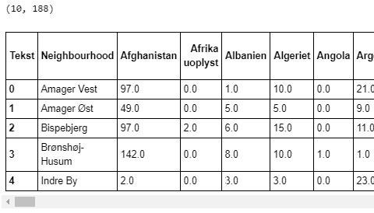
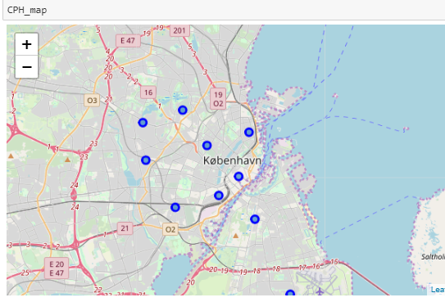
Data output

Slide 6
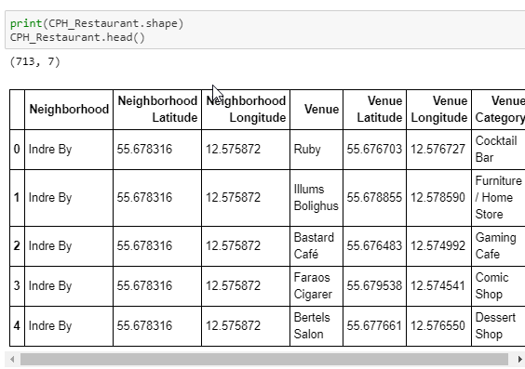
Venues
Foursquare API to obtain

Slide 7
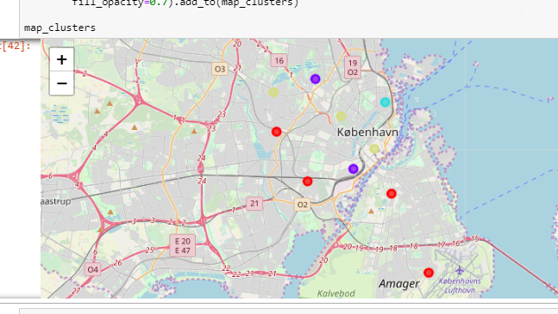
Clustering
The 10 neighborhoods was segmented into 4 clusters by using K-Means and elbow to find the number of clusters.

Slide 8
Conclusion and future project
4 very different clusters
Where we could easily determine where to open our restaurant
For future project it would be adding more data to the project for example income information, gender, age, education etc.

